Slide 1

Utah State Board of Education
Testing Ethics Policy Presentation

Slide 2
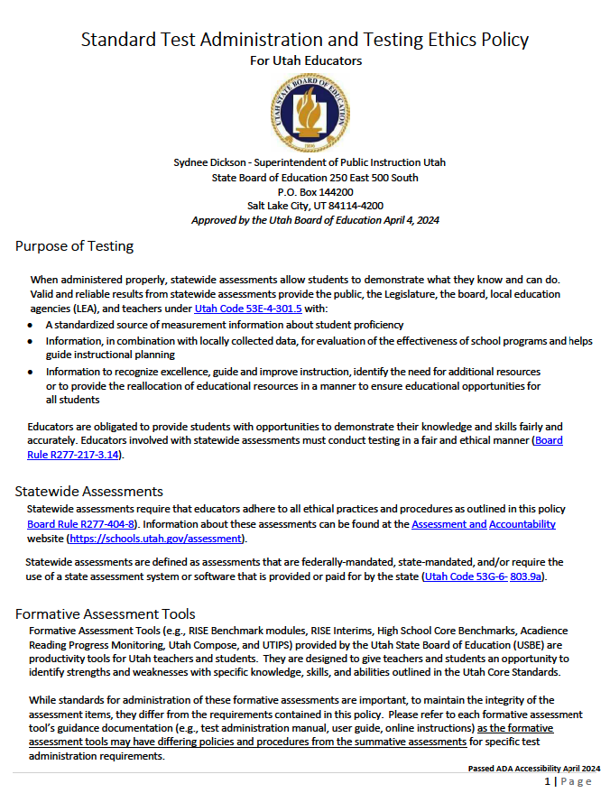
Utah’s Standard Test Administration and Testing Ethics Policy for Utah Educators
Make sure you have a copy of the state’s testing ethics policy. You can get one from your principal.

Slide 3
Organization of the Policy and Presentation
The Standard Test Administration and Testing Ethics Policy is organized by the following headings.
Click on the headings below to go to that part of the presentation. To return to this slide, click on the USBE seal.
Purpose of testing
Assessments
Before Testing: Teaching Practices
During Testing
After Testing
Unethical Testing Practices
Testing Ethics Violations
Resources
Have a copy of the testing ethics policy as you listen to the video.

Slide 4

Purpose of Testing
“When administered properly, statewide assessments allow students to demonstrate what they know and can do."
Educators are obligated to provide students with opportunities to demonstrate their knowledge and skills fairly and accurately. Educators involved with state assessments must conduct testing in a fair and ethical manner.

Slide 5

Assessments
Statewide assessments require that educators adhere to all ethical practices and procedures as outlined in this policy.
With the variety of assessments, how do I know what “statewide assessments” are covered under this policy?

Slide 6
Mandated Assessments
Statewide assessments are…
  Federally-mandated,
  State-mandated, and/or
  Require the use of a statewide assessment system or software that is provided or paid for by the state
That’s great, but give me specifics. What are they?
Take a look at the Assessment and Accountability webpages - https://www.schools.utah.gov/assessment/assessments

Slide 7
State Assessments:
  AAPPL for DLI (not foreign language testing)
  Acadience Reading
  Acadience Math
  ACT (11th grade administration)
  Civics Test (required for graduation)
  DLM (alternate test to RISE and UA+)
  Preschool Entry and Exit Profile (PEEP)
  RISE
  Utah Aspire Plus

Slide 8
Federal Assessments:
  NAEP (selected schools only)
  WIDA ACCESS (for students receiving ML services)

Slide 9
What about district assessments?

Slide 10
District Assessments:
Acadience Reading (4-6)
Reading Comprehension Screener (formerly Growth Measure)
CogAT Universal Screener (6th grade)
ALPS Testing
PSI/PASI Diagnostic Assessments (K-6)
AAPPL for foreign language classes

Slide 11
BEFORE Testing: Teaching Practices
What are the expectations for licensed Utah educators prior to testing?
Provide instruction aligned to the Utah Core State Standards using appropriate, locally adopted curriculum.
Provide accommodations throughout instruction to eligible students as identified by an ML, IEP or 504 team.
Use a variety of assessment processes throughout the year to assess student competency and inform instructional practices.

Slide 12
BEFORE Testing: Teaching Practices
What are the expectations for licensed Utah educators prior to testing?
4. Provide students with a variety of assessment experiences, including feedback on their performance.
5. Use the resources provided for each assessment, as applicable, to familiarize students with the testing tools and question types.

Slide 13
During Testing:
Utah LEAs shall ensure that:
Curriculum and instruction are aligned with Utah Core State Standards.
Parents are provided with procedures regarding student participation in state testing:
o An LEA shall honor parent requests to excuse a student from taking an assessment.

Slide 14
During Testing:
Utah LEAs shall ensure that:
All tests are proctored by a licensed educator.
Educators and support staff who participate in test administration shall complete an annual testing ethics training (R277-404).
Educators review preparation guidelines and test administration manuals (TAM) for the assessment prior to test administration.

Slide 15
During Testing - Licensed Utah Educators Shall Ensure That:
An appropriate environment is set for testing to limit distractions.
All students who are eligible to test are tested or recorded as to why they didn't participate.
A student is not discouraged from participating in testing.
Students have not been penalized for opting out of state assessments.
Students aren't rewarded for participating in or performing well on state assessments.

Slide 16
During Testing - Licensed Utah Educators Shall Ensure That:
Students are provided an alternate learning activity if they are opted out of a statewide assessment. An alternate assessment is an acceptable learning activity.
A proctor is present and active proctoring takes place throughout the entire test session.
A second roving proctor is available to assist with testing in case of unexpected contingencies, technology issues, or student emergencies.

Slide 17
During Testing - Licensed Utah Educators Shall Ensure That:
Students do not use personal electronic devices during testing. All personal devices should be turned off and inaccessible by students.
Any electronic devices that are necessary for a student’s health and safety (i.e., monitoring insulin levels) should be made available if the need arises.
Make-up and test completion sessions are provided for students.
Accommodations are provided to eligible students.

Slide 18
During Testing - Licensed Utah Educators Shall Ensure That:
Test administration procedures are followed according to the test administration manual.
All scripts are read verbatim to students, even during make-up testing sessions or for students who arrive late to the testing session. This ensures that all students have a standardized testing experience.

Slide 19
AFTER testing - LEAs
LEAs SHALL ensure that test results are:
Provided to students and parents within 3 weeks of the LEA receiving them WITH information on how to appropriately interpret scores and reports.
Made available to educators for improving their instruction.
Maintained according to LEA policies and procedures.

Slide 20






After Testing - Licensed Utah Educators Shall Ensure That:
All by-products (e.g. scratch paper, notes, student test tickets) of student testing are collected, secured, and destroyed as appropriate.
All test materials are returned to the test coordinator, as appropriate.

Slide 21
After Testing - Licensed Utah Educators May:
Use a student's score from a state assessment to improve the student's academic grade for or demonstrate the student's competency within a relevant course (53E-4-3 (302-305)).
  REMEMBER: Using a student's score from a statewide assessment can only IMPROVE a student's grade - not hurt it.
  If a student is proficient or higher on a statewide assessment, they receive 100% of the points possible. If a student is not proficient on a state assessment, the grade cannot be negatively impacted.

Slide 22
Other things to note about using a student's score as part of a grade:
REMEMBER: Students cannot be rewarded for taking a statewide assessment. For example:
  Educators cannot assign participation points or extra credit on students' grades for taking a statewide assessment.
  Treats or prizes cannot be given out for proficiency or improving performance on a statewide assessment.

Slide 23
After Testing:
Educators May NOT…
Use a student’s score on a statewide assessment as the sole source to determine whether the student may advance to the next grade level.
Use a student's score on a statewide assessment to determine an overall grade for the course.
Prohibit a student from enrolling in an honors, advanced placement, or International Baccalaureate course based on a student’s score on a statewide assessment or because the student was exempted from taking the statewide assessment (R277-404-6)

Slide 24
Unethical Testing Practices
Review the Unethical Testing Practices on pages 3 and 4 of the Standard Test Administration and Testing Ethics Policy.

Slide 25
Examples of Unethical Testing Practices
Providing instruction from test questions or items
Changing student responses in a test
Rewording or clarifying a student’s test questions
Allowing students to use unauthorized resources to help them on the test (i.e., calculators on the grades 3-5 RISE math assessment)
Displaying materials on classroom walls that are part of a test
Suggesting to a student that they should re-think their responses
Encouraging parents to opt their child out of a test

Slide 26
Testing Ethics Violations
To whom do I report a testing ethics violation?

Slide 27
Jordan District’s Assessment Director
Ben Jameson
801-567-8243 ben.jameson@jordandistrict.org
https://assessments.jordandistrict.org/

Slide 28
Testing Ethics Violations Protocol
Protocol:
An initial investigation should be conducted at the school level.
The LEA assessment director will review the initial investigation and determine findings. Be sure to know who your assessment director is.
If the violation is of sufficient concern, the incident may also be forwarded to the Utah Professional Practices Advisory Commission (UPPAC) for review.
If inappropriate practices are substantiated, educators or other staff may receive further training or a reprimand, be subject to disciplinary action, be terminated, and/or lose their Utah teaching license.

Slide 29
Unethical Testing Practices
Remember, we want to know what the STUDENT knows and can do.
If your actions will cause students to NOT receive a valid and reliable score that accurately reflects what they know and can do, don’t do it!

Slide 30
Thank you!

